Slide 1

PROCESS MINING VIRTUAL INTERNSHIP
by
M. HARSHITHA
Roll No. 214G1A3222
Department of Computer Science and Engineering (Data Science)
Srinivasa Ramanujan Institute of Technology
(Affiliated to JNTUA & Approved by AICTE) (Accredited by NAAC with ‘A’ Grade & Accredited by NBA (EEE, ECE & CSE)
Rotarypuram Village, B K Samudram Mandal, Ananthapuramu – 515701.
2023 - 2024

Slide 2

Contents
Course Objective
Introduction
Technology
Applications
Modules
Real Time applications
Learning outcomes
GitHub Link
Queries

Slide 3
Course Objective
Participants will gain a comprehensive understanding of process mining's versatile applications across industries.
Understanding the fundamental concepts and principles of process mining.
Learning how to apply process mining techniques to real-world datasets.
Gaining knowledge in using process mining tools and software.
Developing skills in process discovery, conformance checking, and performance analysis.
Acquiring knowledge of advanced process mining techniques, such as predictive analytics and decision mining.

Slide 4
Introduction
I did Process Mining Virtual internship from May 2023 to July 2023,through EduSkills-AICTE virtual internship oppurtunity.
The process mining was done in the platform of Celonis website, it helps companies achieve process excellence through its platform by eliminating operational friction with their Intelligent Business Cloud .
Process Mining is a widely-used technology to model, ananlyze, and optimize business process.

Slide 5
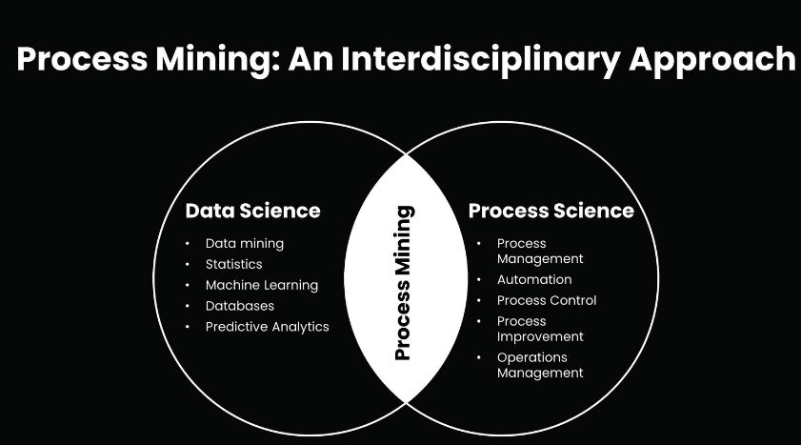
Contd....
The main use of this process mining technique is to find deviations and weak points in business processes.
Process Mining is combination of two disciplines: Data science and Business process Management.

Slide 6
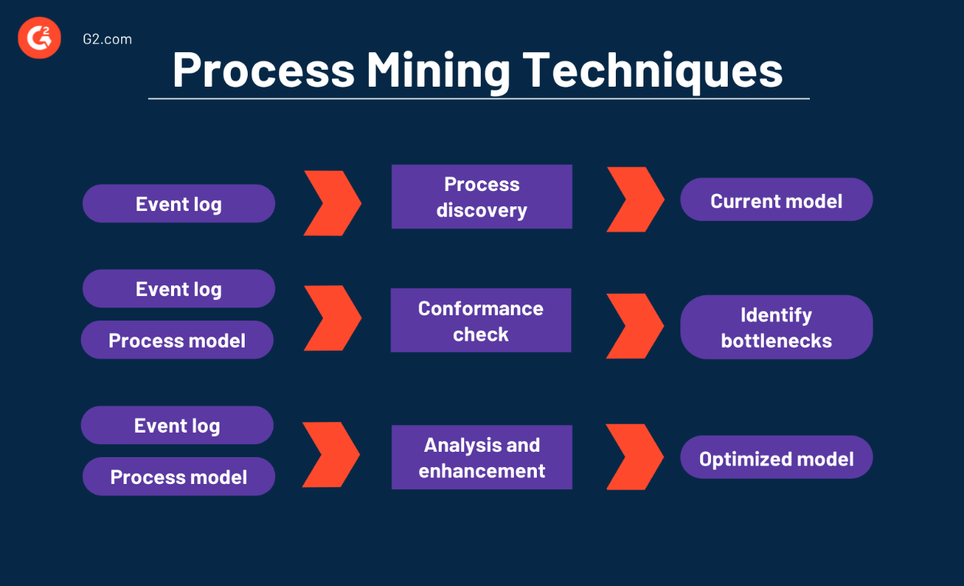
Technology
Process mining technologies encompass a range of tools and techniques that enable the analysis and optimization of business processes.

Slide 7
Contd....
Some popular process mining technologies include:
Process Discovery: These technologies automatically extract process models from event logs, allowing for the visualization and understanding of the actual process flow.
Conformance Checking: These technologies compare the discovered process model with the expected or desired process model, identifying deviations and highlighting areas for improvement.
Performance Analysis: These technologies analyze process execution data to identify bottlenecks, inefficiencies, and opportunities for optimization. They provide insights into process cycle times, resource utilization, and other performance metrics.

Slide 8
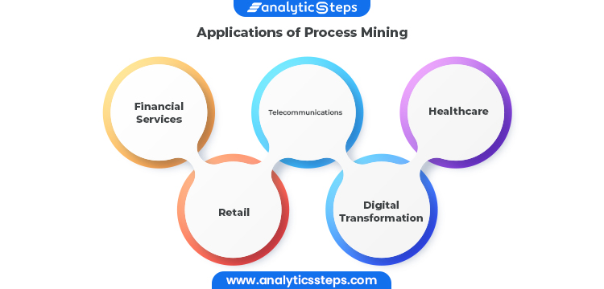
Applications
Healthcare Optimization : In healthcare, process mining can analyze patient treatment processes, hospital workflows, and resource utilization to enhance patient care, reduce waiting times, and improve resource allocation.

Slide 9
Contd....
Financial Services:
In the world of finance and business,where aton of transactions are happening online, process mining is likehaving a super detective that makes sure everything is goingsmoothlyand follows the rules. This is really helpful because rulesand regulations are getting more strict, and companies need to show that they're playing by the rules.
Digital Transformation:
Process mining is frequently used in larger-scale digital transformation initiatives because it can give you the precise insights needed for process improvement, allowing systems to run more quickly, smoothly, and efficiently, as well as objective data-driven insights into the causes of delays and inefficiencies within business processes.

Slide 10
Modules
Data Extraction and Collection:
• In this initial phase, relevant data is extracted from various sources, such as ERP systems, databases, and application logs.
The data collected usually includes timestamps, activity names, case IDs, and other relevant attributes that capture the process execution.
Predictive Analysis:
• Some advanced process mining tools incorporate machine learning techniques to predict future process behaviors based on historical data.
• Predictive analytics can be used to forecast potential bottlenecks or delays and make proactive adjustments.

Slide 11
Contd...
Data Preprocessing:
Raw data often requires cleaning and preprocessing to ensure accuracy and consistency.
Data preprocessing involves tasks like handling missing values, removing duplicates, and transforming data into a suitable format for analysis.

Slide 12
Real-Time Applications
Customer Support and Helpdesk:
By analyzing real-time customer interactions, companies can identify trends in support requests, optimize response times, and enhance the effectiveness of customer support teams.
Risk Management in Banking:
Financial institutions can use process mining to monitor real-time data related to financial transactions and identify potential risks or regulatory non-compliance.

Slide 13
Contd....
Telecommunications Network Monitoring:
Telecom companies can use process mining to monitor their network in real time, ensuring optimal performance, identifying potential outages, and maintaining quality of service.
Emergency Response Coordination:
During emergencies, process mining can help authorities track resources, response times, and coordination efforts in real time to ensure effective disaster response.

Slide 14
Learning outcomes
Interpret process visualizations and leverage analyses to identify process inefficiencies.
Conceptualize your process in terms of activities and cases.
Save an analysis selection for future reference and share it with your team; export visualizations and process data.
Perform the basic tasks necessary to build Celonis analyses.
Become familiar with Analysis Settings and Permissions.
Publish analyses using best practices in version control.
Put your knowledge about the theoretical foundations of Process

Slide 15
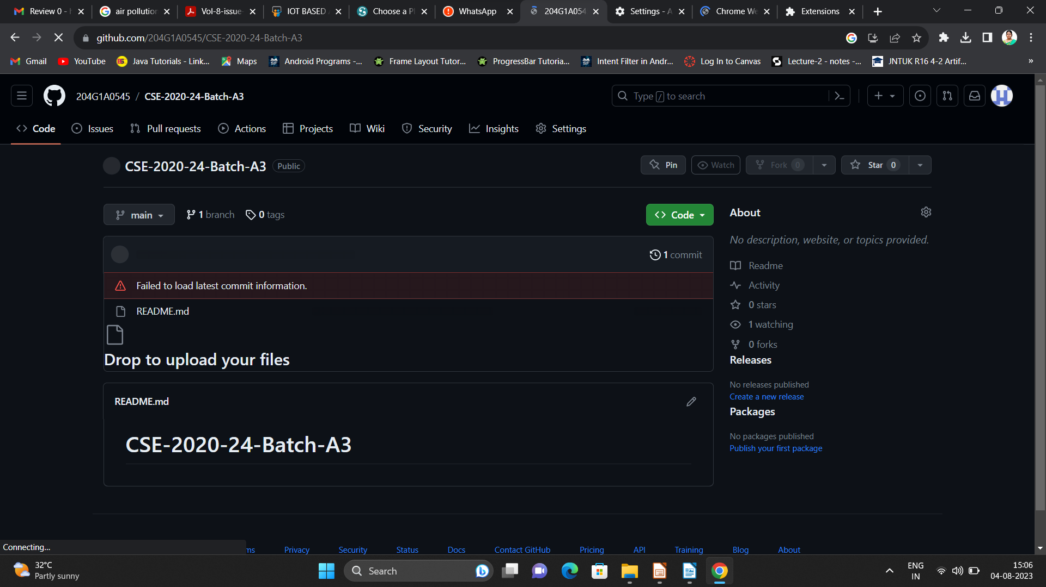

Git Hub Dashboard
Repository Name Like: Summer Internship - I
Under that include document, presentation and Certificate(Pdf).

Slide 16
Any Queries?

Slide 17
Thank You!!!

